Slide 1






Use place value to add and subtract pounds, 10ps and 1ps.
How much money is here?
How do you write that?
£3.65
If I bought something for 60p, how much would be left?
£3.65 - 60p = £3.05
What if I spent just 5p instead?
£3.65 - 5p = £3.60

Slide 2



Use place value to add and subtract pounds, 10ps and 1ps.
How much money is here?
How do you write that?
£4.08
If I found 10p at the bottom of my bag, how much would I now have?
£4.08 + 10p = £4.18

Slide 3
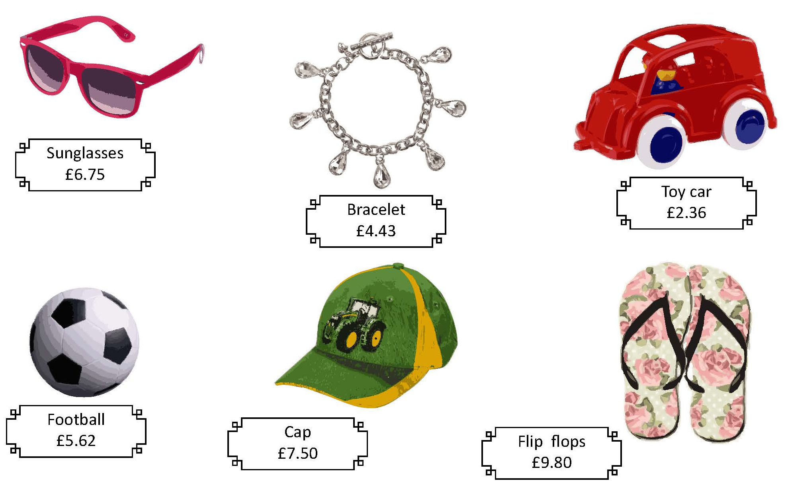
Use place value to add and subtract pounds, 10ps and 1ps.
Let’s check..
£6.95
£4.63
The prices of all of these are going to go up by 20p. Which digit will change?
£2.56
Write the new costs.
£5.82
£7.70
£10.00

Slide 4
Use place value to add and subtract pounds, 10ps and 1ps.
Let’s check..
£6.79
£4.47
This time the prices are going up by only 4p.
Which digit will change this time?
£2.40
Write the new costs.
£5.66
£7.54
£9.84

Slide 5
Use place value to add and subtract pounds, 10ps and 1ps.
Let’s check..
£6.45
£4.13
Now it’s the sales and all the prices are going down by 30p.
Which digit will change?
£2.06
Write the new costs.
£5.32
£7.20
£9.50

Slide 6
Use place value to add and subtract pounds, 10ps and 1ps.
Let’s check..
£5.75
£3.43
What if the prices had been reduced by £1?
Which digit will change?
£1.36
Write the new costs.
£4.62
£6.50
£8.80

